Slide 1
QSO 705 Capstone in Business Analytics
Fall 2023 Final Project Presentation
Physician Resources Limited:
Expanding Business to East of Mississippi
Team Members:
Risha Alam
Shethi Chowdhury

Slide 2
Company overview
Private Company founded in 1984.
Its name was changed to Koha Health in August 2021.
Its primary business purpose is to help organizations grow revenue through Revenue Cycle Management (RCM)
  Collecting and managing a healthcare practice’s revenue from payers based on services provided
PRL is focused on Customer experience
  “provide our clients with loyalty, personal focus, innovation, and a compelling experience.”
Competitors
  Athenahealth
  R1
  MediRevv

Slide 3
Data
Identify healthcare organizations East of Mississippi that do more than $5 million in annual revenue.
Areas to be excluded
    Dentistry, dermatology, ophthalmology, long-term care facilities, and rehabilitations facilities.

Slide 4
Analysis of Physician Data
East of Mississippi

Slide 5
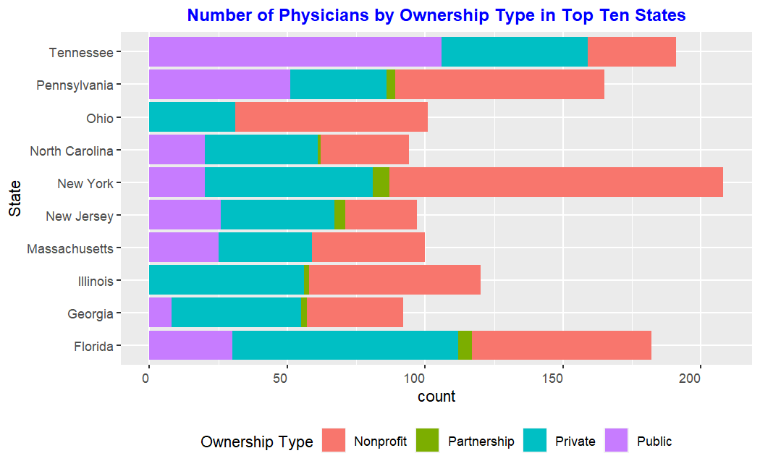
New York has the highest number of physicians from which most of the physicians are working for nonprofit companies.
Tennessee has the second highest number of physicians and most of them are working for Public companies.
Florida has the third highest number of physicians and most of the physicians are working for private companies there.

Slide 6
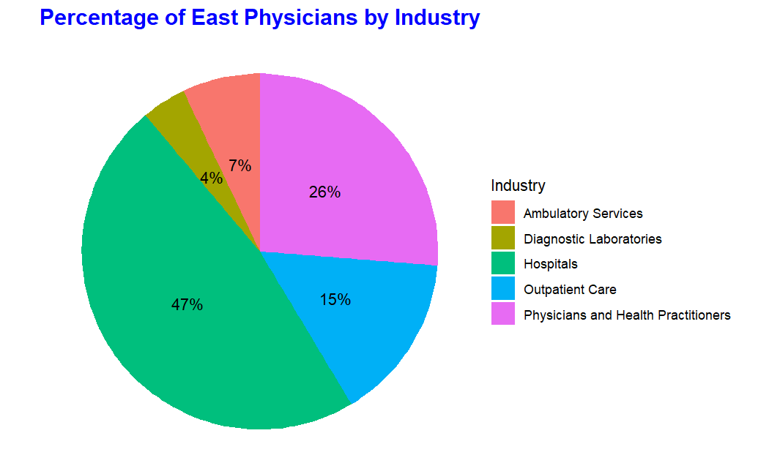
Most of the physicians (47%) are working for Hospitals followed by 26% working Physicians and Health practitioners.
Least number of physicians (4%) are working for Diagnostic Laboratories followed by 7% working for Ambulatory Services.

Slide 7
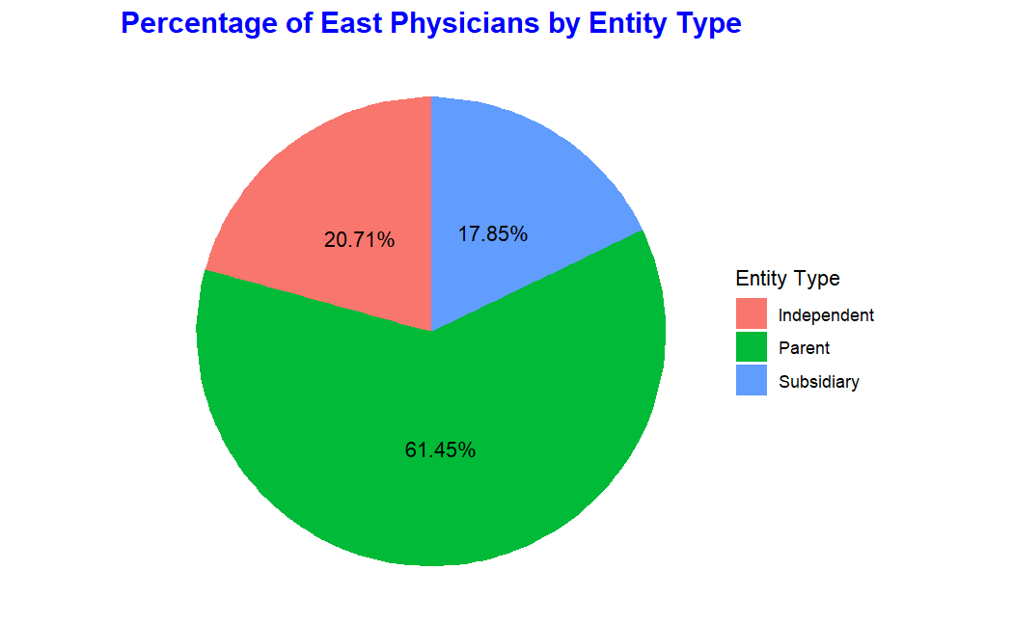
Most of the physicians (61.45%) are working for Parent companies followed by 20.71% Physicians working for Independent companies.
17.85% of the physician works for Subsidiary companies.

Slide 8
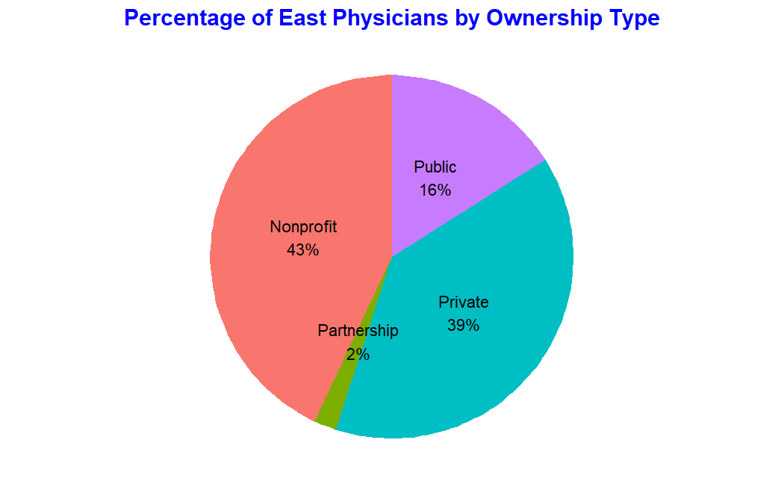
Most physicians (43%) are working for Nonprofits followed by 39% working for Private Companies.
Of the remaining 16% are working for Public Companies and only 2% are working for partnerships.

Slide 9
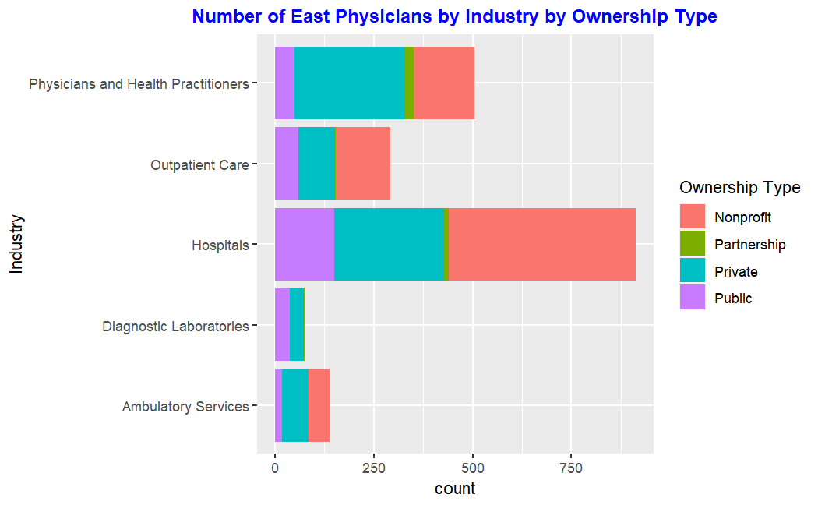
Most of the physicians work for hospitals.
Most hospitals are non-profit followed by private ownership type.
Ambulatory Services and Outpatient Care do not have any Partnership Ownership Type.

Slide 10
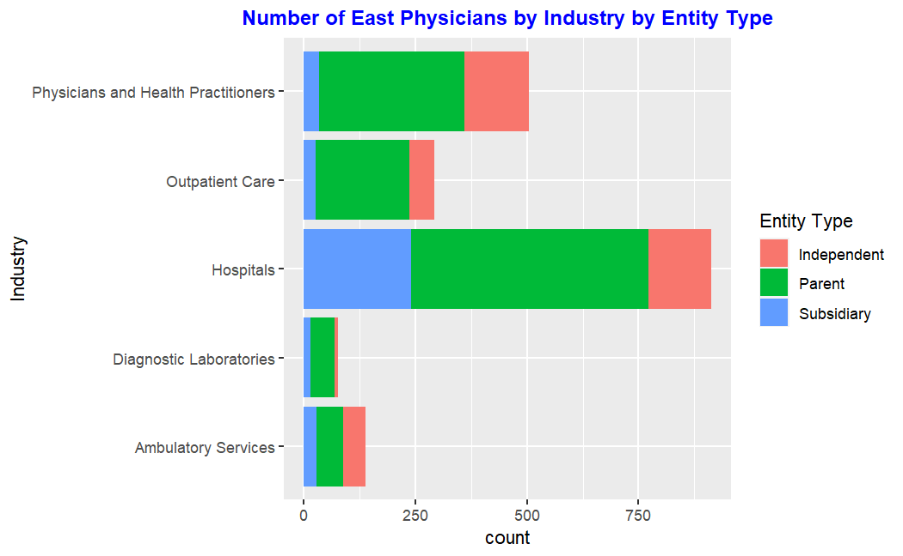
Hospital has the greatest number of Parent Entity Type followed by Subsidiary Entity Type compared to other Industries.
Ambulatory Services has almost same amount of Independent, Parent and Subsidiary Entity Type.

Slide 11
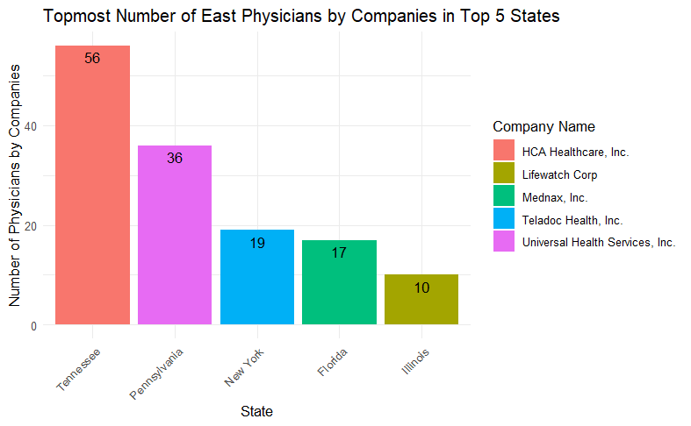
This chart shows us that HCA Healthcare has highest number of physicians in Tennessee with 56 followed by Universal health in Pennsylvania with 36.
Of the remaining in top 5 NY, FL and IL has the physicians with 19, 17 and 10 in the respective companies.

Slide 12
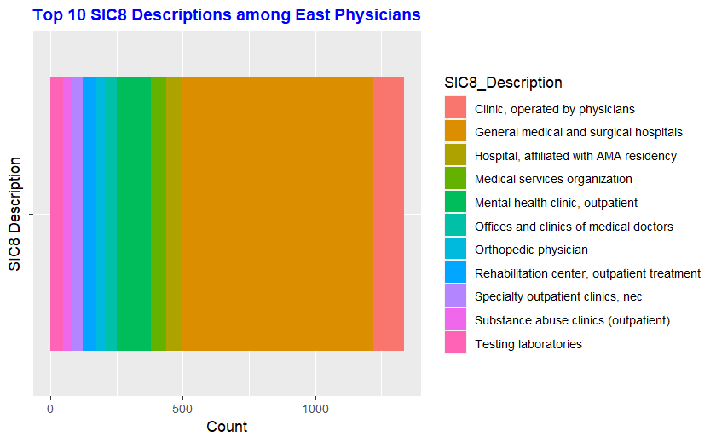
The area chart shows the distributions of physicians by SIC8 categorical description.
It shows that the highest number of 728 physicians are under General medical and surgical hospitals followed by Mental Health clinic with 130.
47
50
130
59
55
728
114

Slide 13
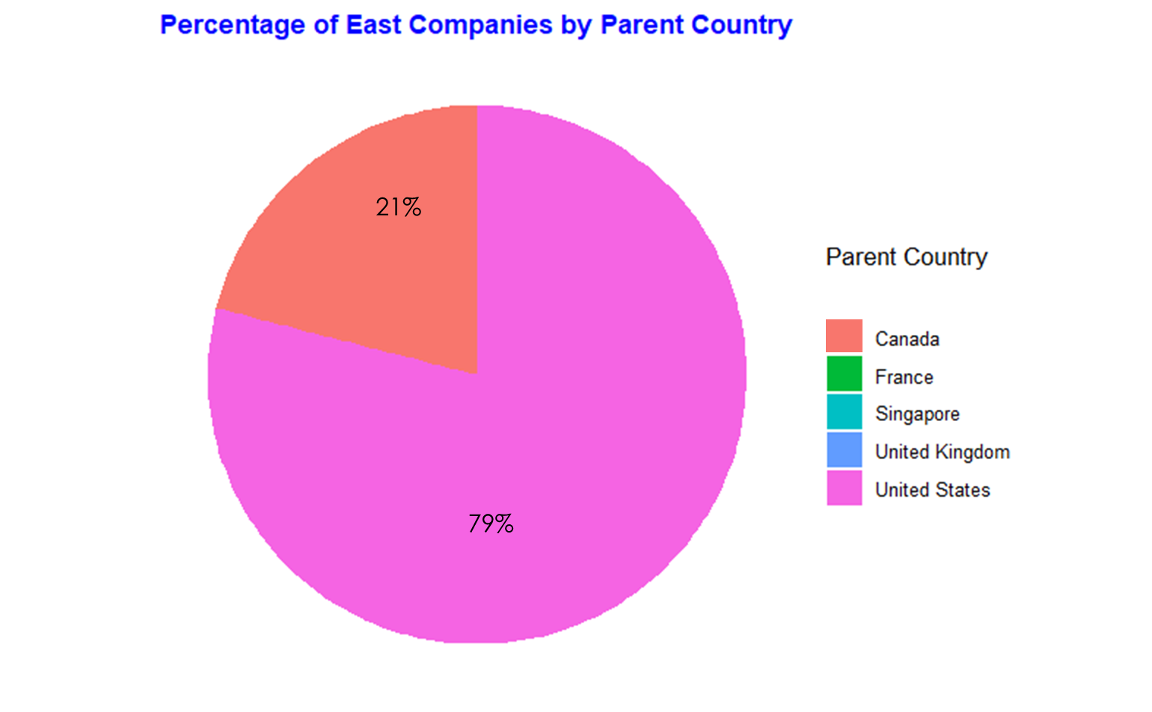
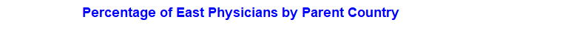
In the pie chart, we can see the percentages of the physicians by their parent country.
By percentages we can see that USA has the highest physicians with 79% followed by Canada with 21%.

Slide 14
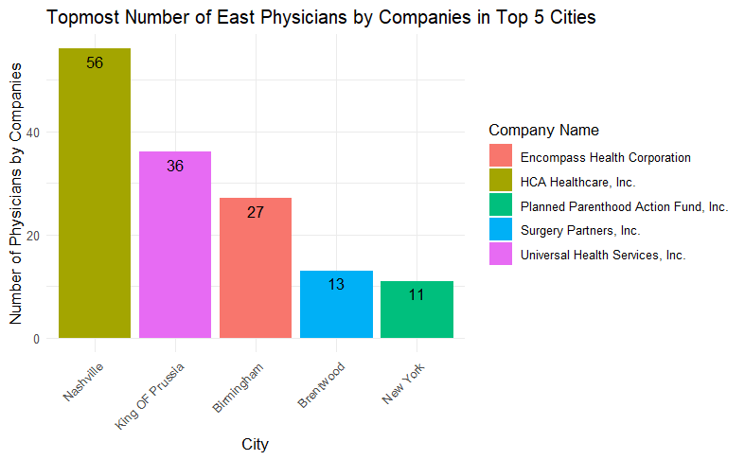
This chart shows us that HCA Healthcare has highest number of physicians in Nashville with 56 followed by Universal health in King of Prussia with 36.
Of the remaining in top 5 Birmingham, Brentwood and NY has the physicians with 27, 13 and 11 in the respective companies.

Slide 15
Analysis of Companies Data
East of Mississippi

Slide 16
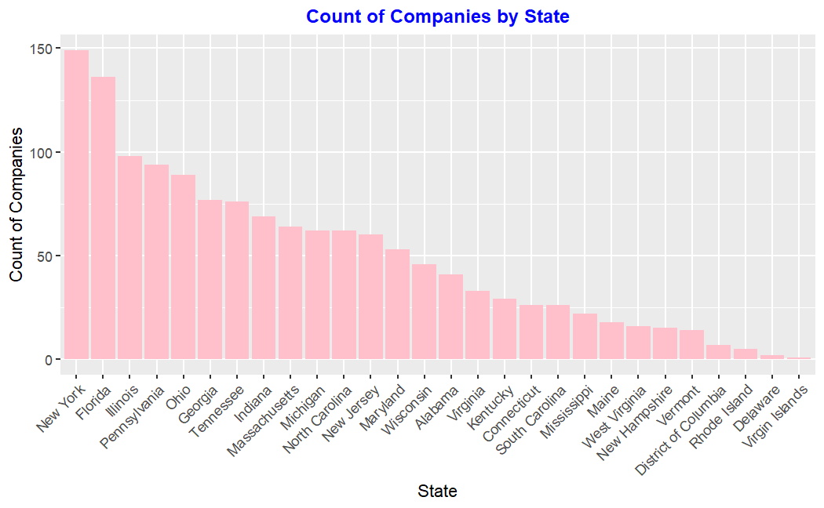
New York has the highest number of companies among the East states followed by Florida and Illinois.
Virgin Islands has the lowest number of companies among the East States followed by Delaware and Rhode Island.

Slide 17
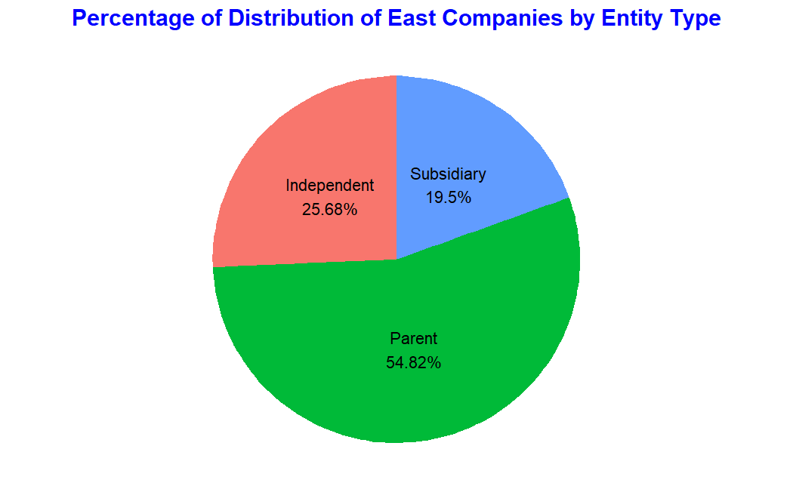
Most of the Companies (54.82%) are under Parent Entity Type.
Of the remaining 19.50% companies are under Subsidiary Entity Type and 25.68% of the companies are under Independent Entity Type.

Slide 18
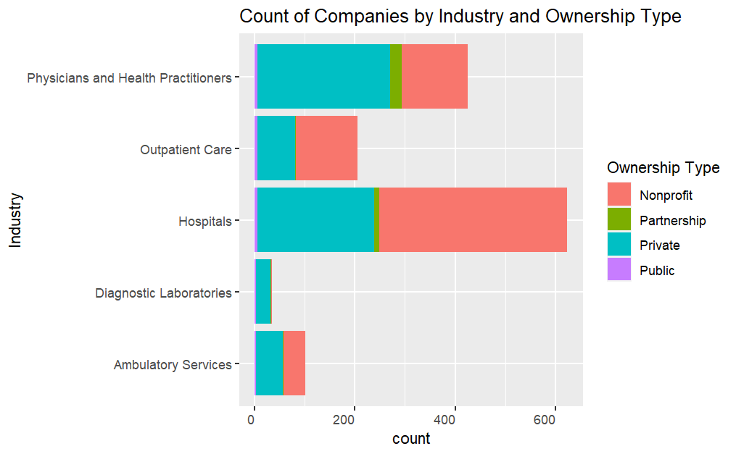
Hospital has the greatest number of companies among which most of the companies are nonprofit and very few public.
Physicians and Health Practitioners has the highest number of private companies.
Ambulatory Services does not have any company with partnership ownership type.

Slide 19
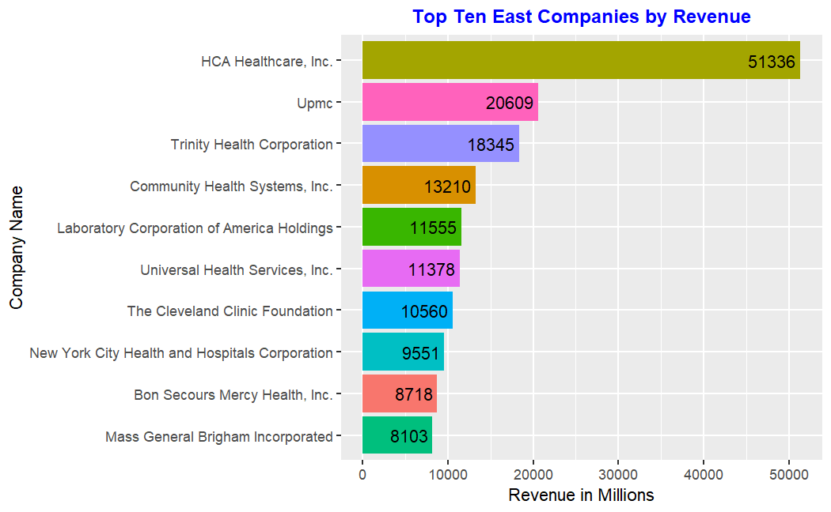
HCA Healthcare, Inc. has the most revenue at 51.3 billion USD followed by Upmc at 20.6 billion USD.
Rest of the top ten companies range in revenue from 18.3 billion to 8.1 billion USD.

Slide 20
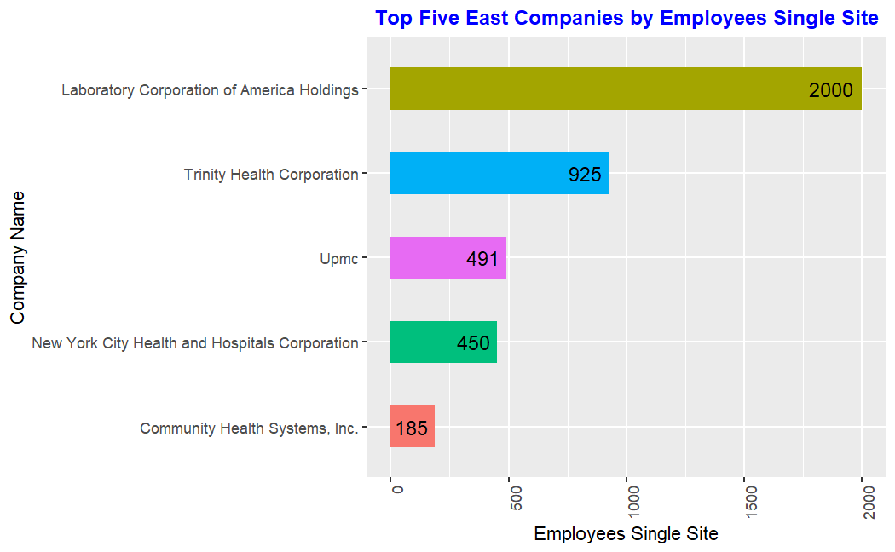
With the highest count of 2000 employees at a single site, Laboratory Corporation of America Holdings stands out as the company with the largest workforce concentration in a single location among the top five Followed by Trinity Health Corporation.
The rest of the companies Single Site Employee count range from 491 to 185.

Slide 21
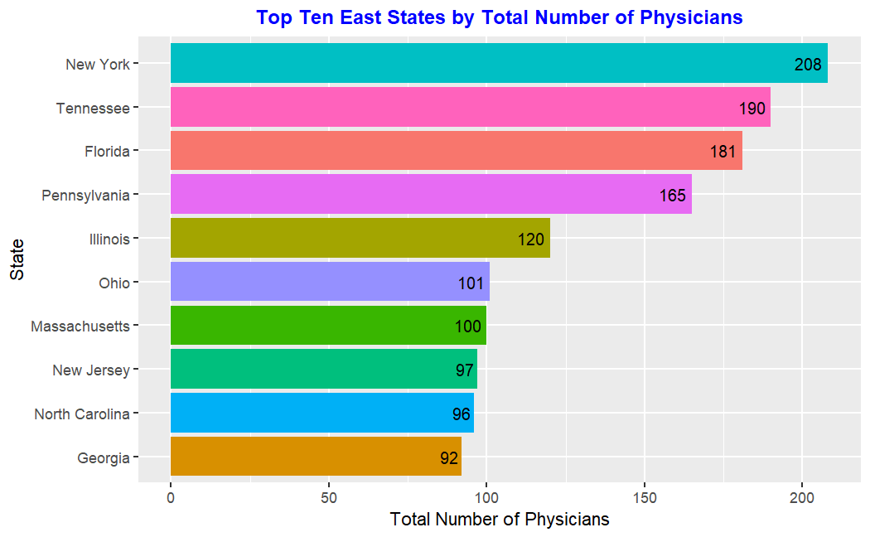
Companies in New York has the greatest number of Physicians (208) followed by Tennessee which has 190 physicians.
Companies in the last four states of the top ten have total physicians between 100 to 92.
Companies in the four remaining top ten states have total physicians ranging between 181 to 101.

Slide 22
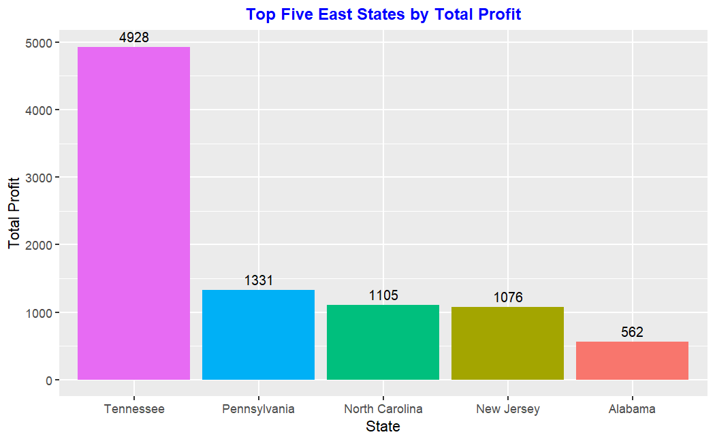
Companies in Tennessee generated the most profit 4.9 billions in dollars followed by Pennsylvania at 1.3 billion USD.
Companies in the last state in the top five generated profit of 0.5 billion USD.
Companies in the two remaining top five states generated profit between 1.1 and 1.08 billions USD.

Slide 23
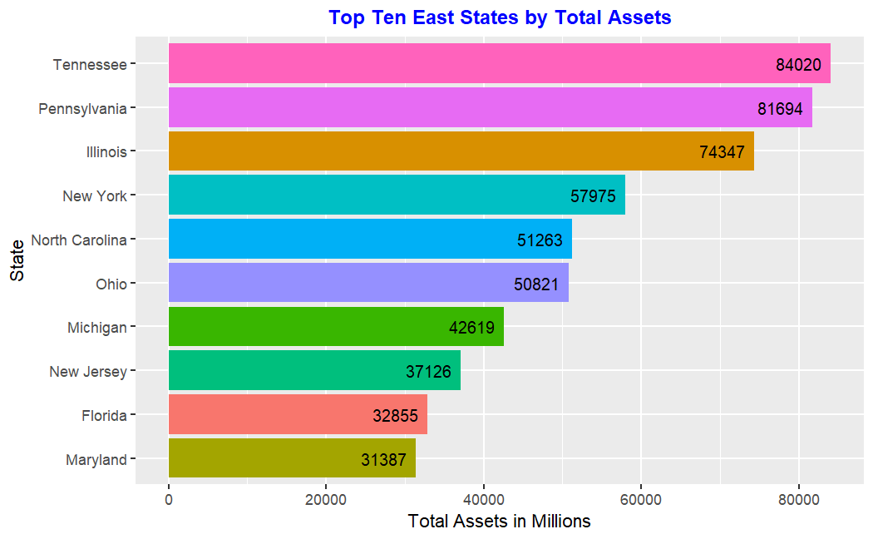
Companies in Tennessee have the most asset 84 billions in dollars followed by Pennsylvania at 81.7 billion USD.
Companies in the last four states in the top ten have assets between 42.6 and 31.4 billions USD.
Companies in the four remaining top ten states generated between 74.3 and 50.8 billions USD.

Slide 24
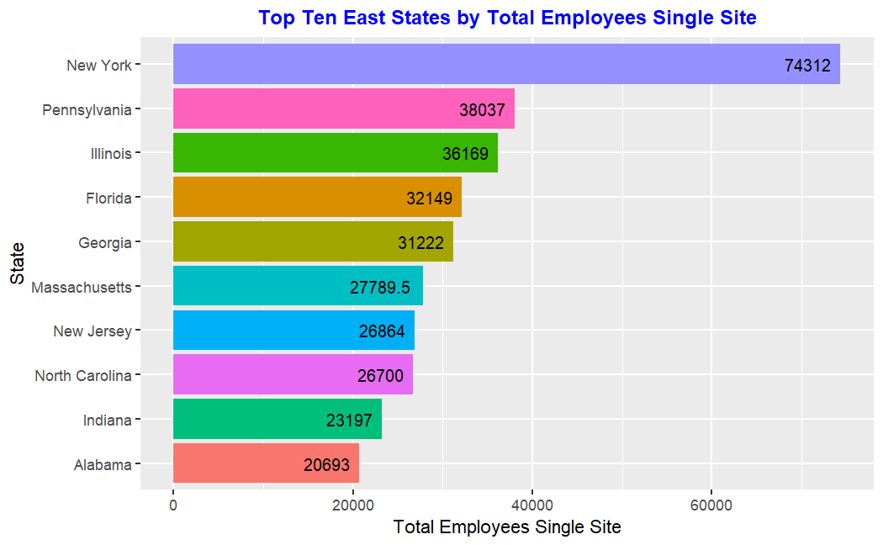
Companies in New York has the greatest number of Single site employees (74312) followed by Pennsylvania which has 38037 Single site employees.
Companies in the last four states of the top ten have total Single site employees between 36169 to 27790.
Companies in the four remaining top ten states have total Single site employees ranging between 26864 to 20693.

Slide 25
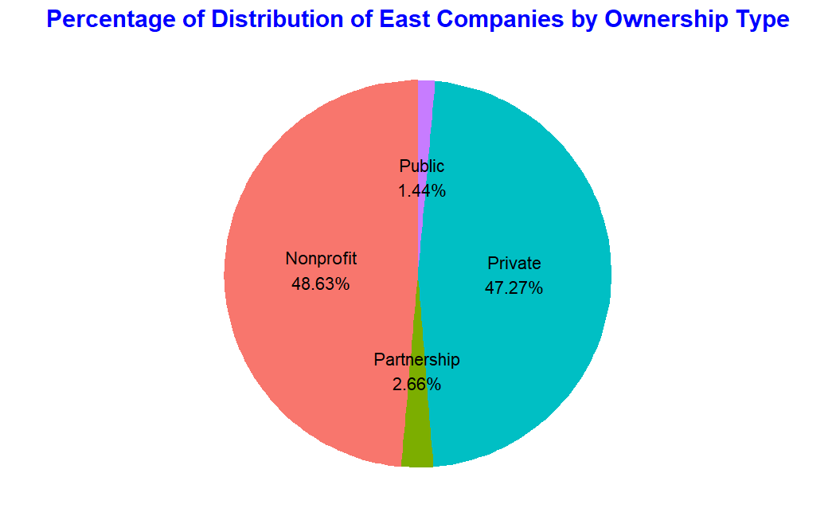
Most of the companies (48.63%) are Nonprofit followed by 47.27% are Private Companies.
Of the remaining 2.66% are Partnership Companies and only 1.44% are Public.

Slide 26
Conclusions
The analysis of physician and company data across the East of Mississippi region reveals several key insights into the healthcare landscape.
New York emerges as a hub for physician employment, particularly in nonprofit hospitals, while Tennessee and Florida also boast significant physician populations.
Revenue and specialty concentrations vary across states, with areas like New York and Pennsylvania showing higher revenue potential.
Targeting specific areas and specialties based on physician concentration and revenue potential can lead to more effective service provision strategies and greater revenue generation.

Slide 27
Recommendations
1. Number, Size, and Type of Practices to Target:
Large Hospitals in New York: With the highest number of physicians, targeting large hospitals in New York could provide ample opportunities for service provision. Nonprofit hospitals particularly dominate this market, suggesting a focus on not-for-profit healthcare providers.
Public Companies in Tennessee: Tennessee hosts a substantial number of physicians, many of whom are employed by public companies. Targeting these organizations, which may include government-run healthcare facilities, could offer lucrative opportunities for collaboration or service provision.
Private Companies in Florida: Given the significant presence of private companies in Florida, targeting these entities could provide avenues for partnership or service provision. Private companies may be more open to collaborations with external service providers.

Slide 28
Recommendations
2. Areas and Specialties to Target by Revenue and Location:
High-Revenue Areas such as New York and Pennsylvania: Companies in New York and Pennsylvania exhibit high revenue generation, suggesting these areas as lucrative markets for service providers. Targeting these regions could lead to higher revenue opportunities.
Specialties with High Physician Concentration: Specialties such as General Medical and Surgical Hospitals and Mental Health Clinics have a high concentration of physicians. Focusing on these specialties could result in greater service demand and revenue generation.
Geographic Areas with Concentrated Physician Presence: Locations like Nashville, King of Prussia, and Birmingham have a high concentration of physicians employed by major healthcare companies. Targeting these regions could lead to better market penetration and service utilization

Slide 29
Thank you.
Any Questions?

